Slide 1

Sri Sathya Sai National Healthcare Committee (SSSNHC)​

Slide 2
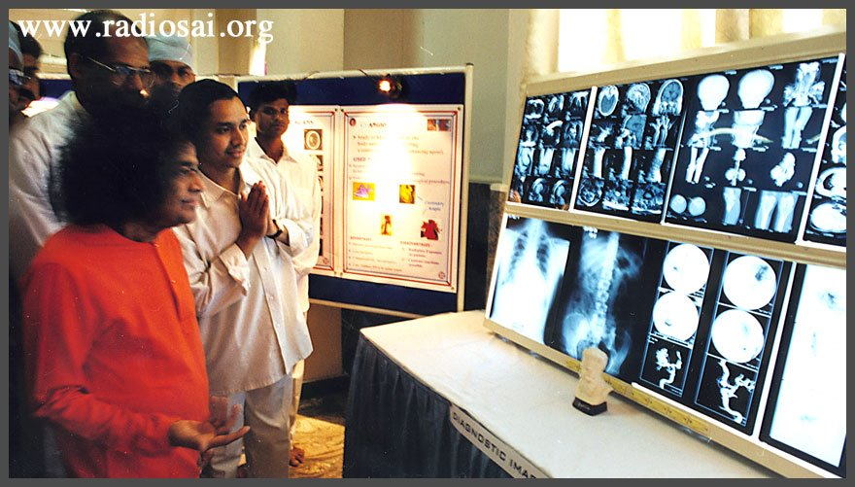
Sathya Sai Speaks
‘’Look upon patients as your own kith and kin, as your special guests and as your closest friends and attend to them lovingly and with unflinching unwavering care”. ​
“Doctors should serve the poor with a spirit of sacrifice. There is no greater service than this. As man is the embodiment of God, it is their primary duty to help the destitute and the forlorn”​

Slide 3
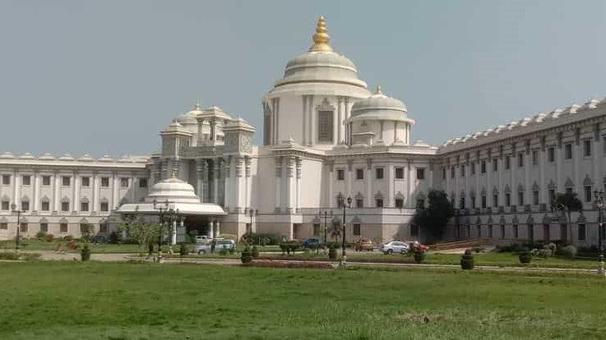
Sri Sathya Sai Organisation UK
Bal Vikas (SSE)
Service
Spiritual
Healthcare
Young Adults (YA)

Slide 4
National Objectives
UK healthcare activities
Overseas medical camps
Medical rotations at International Sai Hospitals
Medical and non-medical volunteers for medical camps during Guru Poornima and Bhagawan Sri Sathya Sai Baba’s Birthday celebrations in Prashanti Nilayam, India

Slide 5
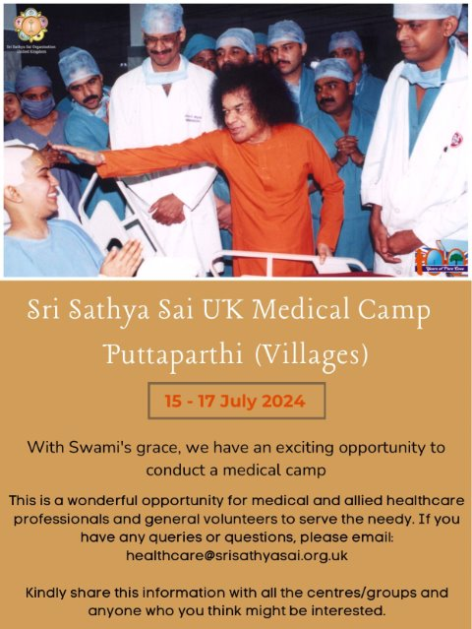

Slide 6
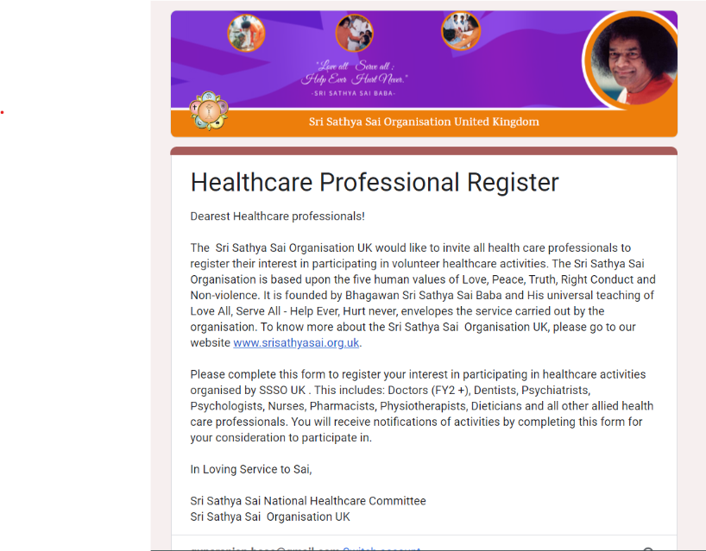
Registration – Healthcare Professional’s Database R4
https://docs.google.com/forms/d/e/1FAIpQLSfDt2BHFOHjwhPQjLepZaVYKZrNcGakWW0BmGgVmRnUdwR0fw/viewform

Slide 7
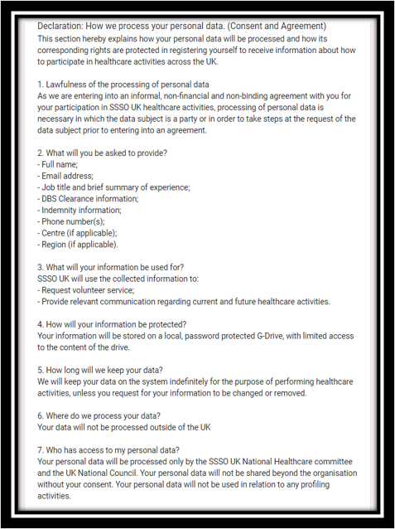
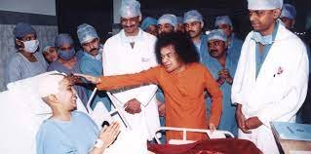
Details asked on form

Slide 8

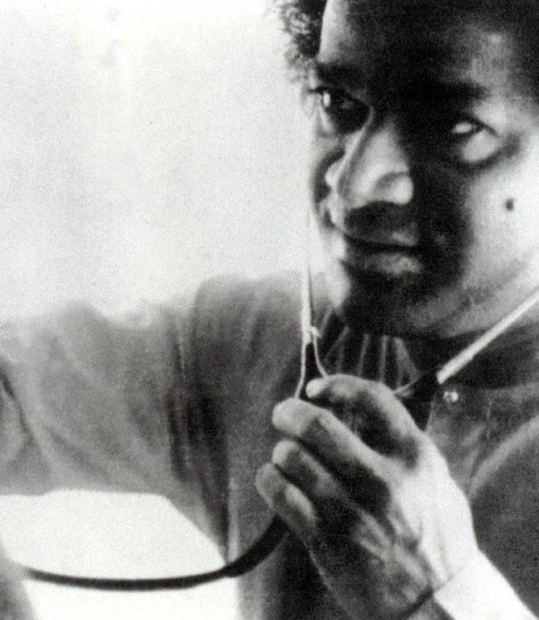
Regional Healthcare
Activities
Organise blood donation (100 pints for Swami’s 100th birthday)
Bridge
Replicate Bridge programme (medical camps for the homeless) in / around Birmingham
Webinars
Organise and participate in webinars
Blood donation

Slide 9
Why Donate?
Giving blood saves lives​
The blood you give is a lifeline in an emergency and for people with long-term conditions, e.g.​
    Anaemia ​
    Cancer ​
    Blood disorders ​
    Surgery ​
    Blood transfusions ​
https://www.blood.co.uk/why-give-blood/who-you-could-help/​
One unit of blood could treat up to 3 different patients​
Demand for different blood types, especially from ethnic minorities​

Slide 10
What do you need to do?
Give your Centre Service Coordinator your contact information if interested​
If you are not already registered as a donor:​
    Log into www.blood.co.uk OR call 0300 123 2323​
    Check if you meet the requirements (also see next slide)​
    Register as a blood donor​
    You will receive a Blood Donor ID​
Optionally download the app (search “NHS Give Blood” on app stores)​
Book a location, date and time to donate, via the website or the app​
Provide your Blood Donor ID, and donation date and time, to your Centre Service Coordinator​
If you have any further questions, please ask your Centre Service Coordinator, or contact: gunaranjan.bose@gmail.com / bhavnaapatel80@gmail.com ​
​

Slide 11
General Requirements
Are fit and healthy​
Weight between 7st 12lbs (50kg) and 25 stone (158kg)​
Aged between 17 – 65 inclusive (or 70 if you have given blood before)​
Are over 70 and have given blood in the last 2 years​
Men can give blood every 12 weeks, women can give blood every 16 weeks ​
Common reasons you should check if you can give blood are:​
If you are receiving medical or hospital treatment​
If you are taking medication / have a cold​
After travelling outside of the UK​
After having a tattoo or piercing​
During and after pregnancy​
If you have cancer​
After receiving blood, blood products or organs after 1 January 1980​
Detailed information and self-check: Blood.co.uk, or call 0300 123 2323​

Slide 12
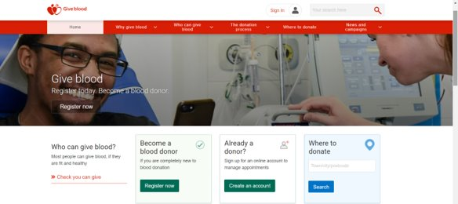
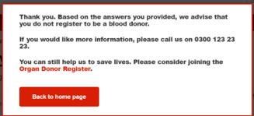
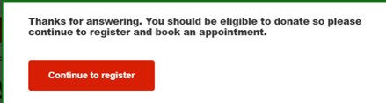
Registration Process
Log onto Blood.co.uk​
Check whether you can give blood​
Register to be a donor online:​
Answer general and health questions to check whether you qualify as a donor ​
Enter email and create password​
Confirm email, by clicking link sent on email and fill out personal details in the form provided​
That’s it! Registration Complete ​
You can now choose an appointment!​

Slide 13
On the day
When you arrive at your appointment, complete a health check questionnaire and drink 500ml of water. ​
Have a private health screening with a friendly member of the team. ​
Take a seat and give blood for 5-10 minutes. ​
​
Enjoy a free drink and snack while you rest for 15 minutes.​
You're all done. Your donation will help save up to three lives.​
​
*Cancellations to be done 3 days prior to the appointment​

Slide 14
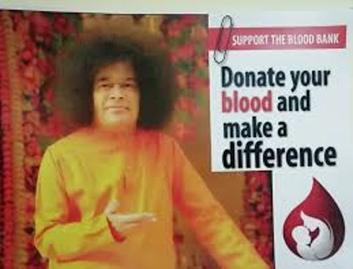
‘’No Joy Can Equal the Joy of Serving Others’’
-Sai Baba
All information presented was taken directly from ​
Blood.co.uk

Slide 15
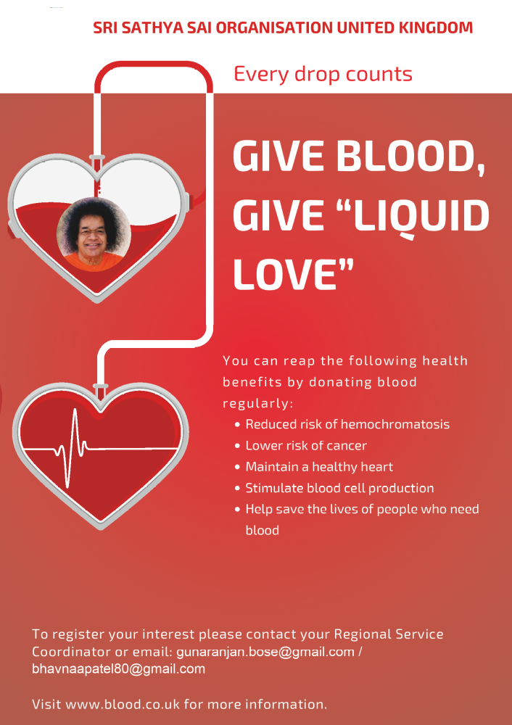

Slide 16
Local blood donation centre (Leicester)
 | Venue | Address
 | Enderby, Brockington College | Brockington College, Blaby Road, Enderby, Leicester, LE19 4AQ
 | Whetstone, Whetstone Baptist Church | Springwell, Dog & Gun Lane, Whetstone, Leicester LE8 6LJ
 | Braunstone Civic Centre | 209 Kingsway, Braunstone, LEICESTER, LE3 2PP
 | Broughton Astley, Broughton Astley Leisure Centre | Broughton Way, Broughton Astley, LEICESTER, LE9 6AZ
 | Wigston, Holiday Inn Leicester Wigston | Leicester Road, Wigston, LE18 1JW
 | Leicester Donor Centre | Mansion House, Ground Floor, 41 Guildhall Lane, Leicester, LE1 5FQ
 | Mountsorrel, Soar Valley Leisure Centre | Kingfisher Road, Mountsorrel, LE12 7FG

Slide 17
APPENDIX

Slide 18
Local blood donation centre (Narborough)
 | Venue | Address
 | Enderby, Brockington College | Brockington College, Blaby Road, Enderby, Leicester, LE19 4AQ
 | Whetstone, Whetstone Baptist Church | Springwell, Dog & Gun Lane, Whetstone, Leicester Le8 6LJ
 | Braunstone Civic Centre | 209 Kingsway, Braunstone, LEICESTER, LE3 2PP
 | Broughton Astley, Broughton Astley Leisure Centre | Broughton Way, Broughton Astley, LEICESTER, LE9 6AZ
 | Wigston, Holiday Inn Leicester Wigston | Leicester Road, Wigston, LE18 1JW

Slide 19
Local blood donation centre (Narborough)
 | Venue | Address | Website
 | Wolverhampton, Wolverhampton Racecourse | Dunstall Park Wolverhampton WV6 0WY | https://my.blood.co.uk/your-account/where-to-donate/donation-venue/?searchCriteria=WOLVERHAMPTON&searchCriteriaPretty=Wolverhampton&venueId=CV01J

Slide 20
Local blood donation centre (Birmingham)
 | Venue | Address
 | Birmingham Blood donor centre | Dunstall Park 2nd Floor, 65 New Street Birmingham B2 4DU

Slide 21
Local blood donation centre (Wolverhampton)
 | Venue | Address
 | Wolverhampton, Wolverhampton Racecourse | Dunstall Park Wolverhampton WV6 0WY
 | Fordhouses, The Pavillion Club | Pavilion Sports & Social Club Stafford Road WOLVERHAMPTON WV10 6AJ
 | Perton, Perton Civic Centre | Church Road Perton WOLVERHAMPTON WV6 7PD
 | Willenhall, Willenhall Chart Centre | 19 Gomer Street WILLENHALL WV13 2NS
 | Coseley, Darkhouse Baptist Church | Darkhouse Lane Coseley BILSTON WV14 8XH
 | Sedgley, Church of Jesus Christ | of Latter Day Saints Tipton Road Woodsetton DUDLEY DY3 1BZ

Slide 22
Local blood donation centre (Leicester)
 | Venue | Address | Website
 | Wolverhampton, Wolverhampton Racecourse | Dunstall Park Wolverhampton WV6 0WY | https://my.blood.co.uk/your-account/where-to-donate/donation-venue/?searchCriteria=WOLVERHAMPTON&searchCriteriaPretty=Wolverhampton&venueId=CV01J

